Slide 1

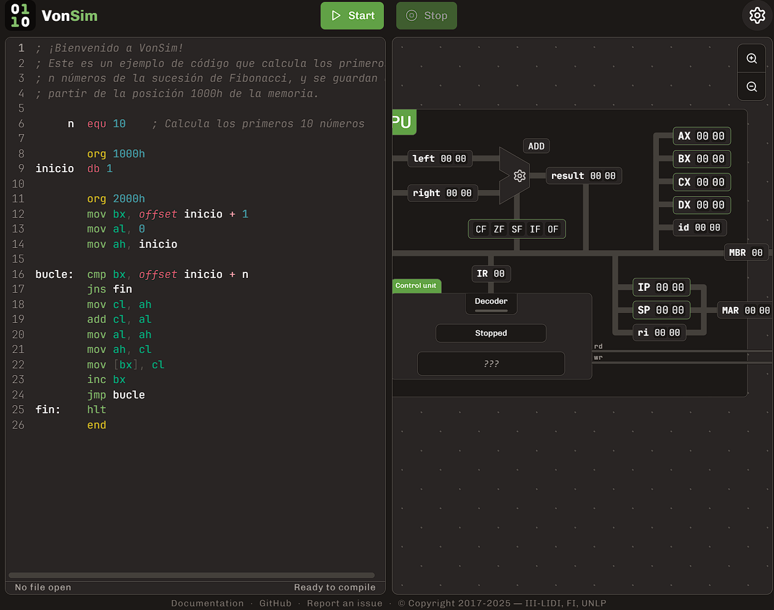

VonSim
Educational Simulator for Assembly
https://vonsim.github.io/
Notes:
Hi! I want to tell you about VonSim, an educational simulator for learning Assembly.

Slide 2

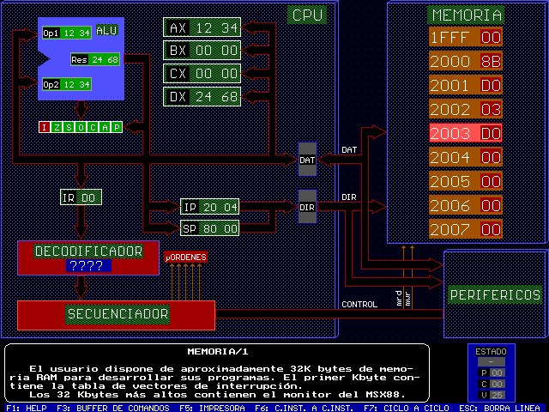


Context
Informatics School
Universidad Nacional de La Plata
Courses that teach Assembly
Computer Organization
Computer Architecture
~1500 students per year
Previously: MSX88 simulator
VonSim 1: 2017
VonSim 2: 2023
MSX88
Notes:
We created VonSim for our courses that teach Assembly at the Universidad Nacional de La Plata, where we have more than a thousand students per year. Previously, we used a very old simulator called MSX88, and VonSim was born as a web application that provided a backwards compatible version of the instruction set. VonSim is now 8 years old, and has had a very positive impact in the learning experience.

Slide 3






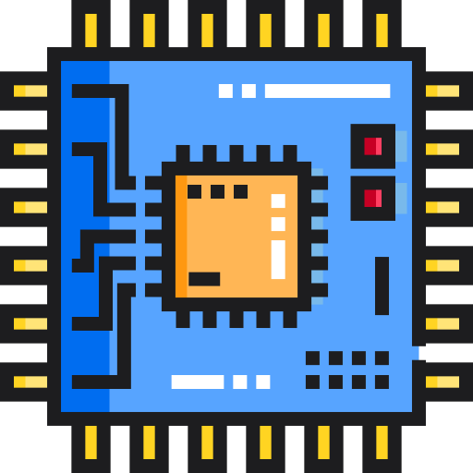




https://vonsim.github.io/
Web App
IDE
Compile & Ex
Debug
Simplified Architecture
Component Visualization
I/O Devices
Integrated Examples
Mobile/Tablet mode
Notes:
So, what is VonSim?
VonSim is a web application that features an integrated editor and simulator for a simplified x86 architecture.
Students can write and run programs directly in VonSim, and visualize the CPU, Buses, Memory and I/O devices as instructions are executed.
It also has other cool features, such as an integrated example gallery, mobile layout, and easy sharing of code with a QR code.
VonSim is open-source and free to use.

Slide 4
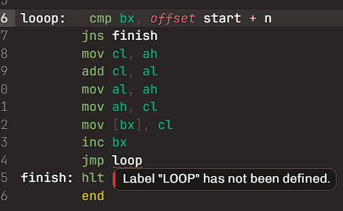
IDE
Syntax Coloring
Continuous compilation
Detailed error messages with visual feedback
Notes:
The IDE features continuous compilation and detailed error messages that allow quick feedback cycles and promote student independence.

Slide 5
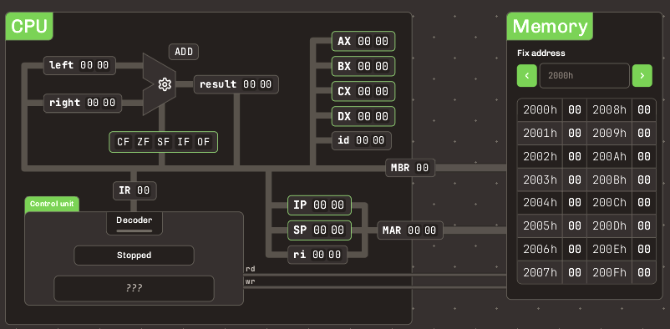
CPU/Memory
8 half registers - 8 bits each: AL, AH, BL, BH, Cl, CH, DL, DH
Can be addressed as 4 16-bit registers: AX, BX, CX, DX
Low/high parts
Especial state registers
ALU
Memory: 16838 bytes
16 bit addresses
Notes:
The 16-bit architecture features only 4 registers: AX, BX, CX and DX.
These can be addressed as half-registers with alternative names: AH, AL, and so own, where H stands for High and L for Low.
It also includes typical state registers such as the Instruction and Stack Pointers, and a fixed-point Arithmetic Logic Unit

Slide 6
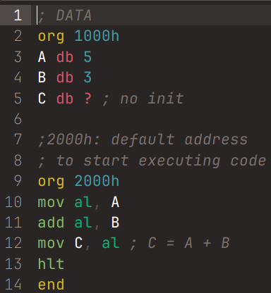
Simplified 8088 Assembly
Compute C = A + B
ORG <ADDRESS>
Explicit starting address for code/data
END
MOV dest, source
Data transfers
OP dest[, source]
OP = ADD | SUB | OR | AND | XOR | NEG | NOR
hlt
Stop execution
Notes:
The simplified assembly instruction set requires specifying the memory layout manually with the ORG instruction.
The MOV instruction allows moving data between registers, or registers and memory. Indirect addressing can only be performed using the BX register. The Arithmetic Logic Unit can only perform only logical operators and sums.

Slide 7
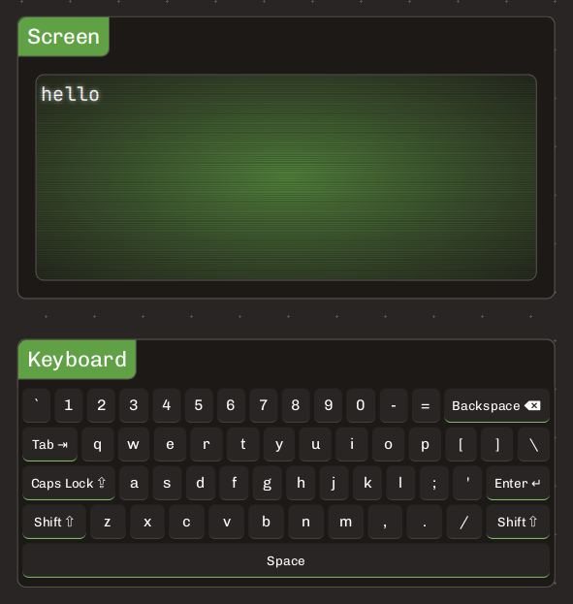
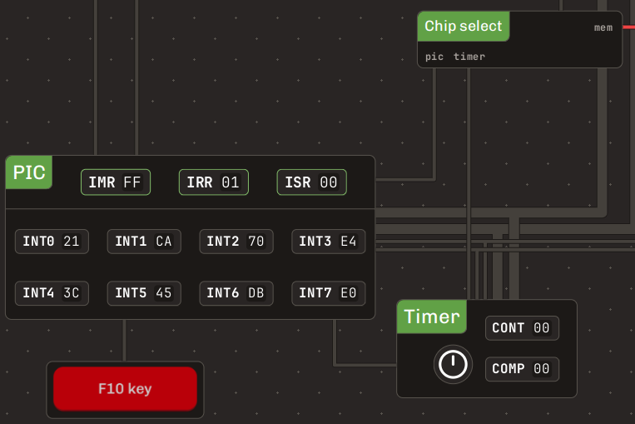
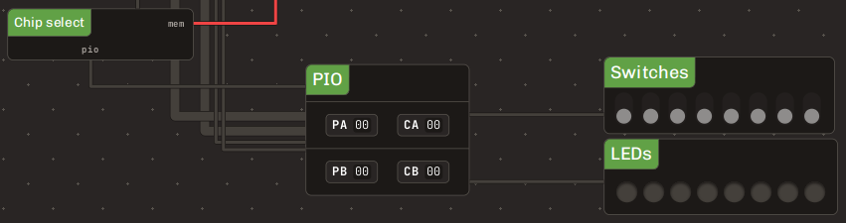

Device I/O
Keyboard & Screen
PIC
→ Timer
→ F10 Button
→ HANDSHAKE
PIO
→ LEDs & Switches
→ Printer
HANDSHAKE
→ Printer
Notes:
VonSim also features a rich set of Input/Output Devices such as a keyboard, screen, switches, leds and a printer. These can be accessed via different internal devices via either hardware interrupts with the Programmable Interrupt Controller or polling. Communication with the devices can be performed via the Programmable Input Output device (PIO) or the HANDSHAKE, which is specialized for the Centronics printer protocol.

Slide 8
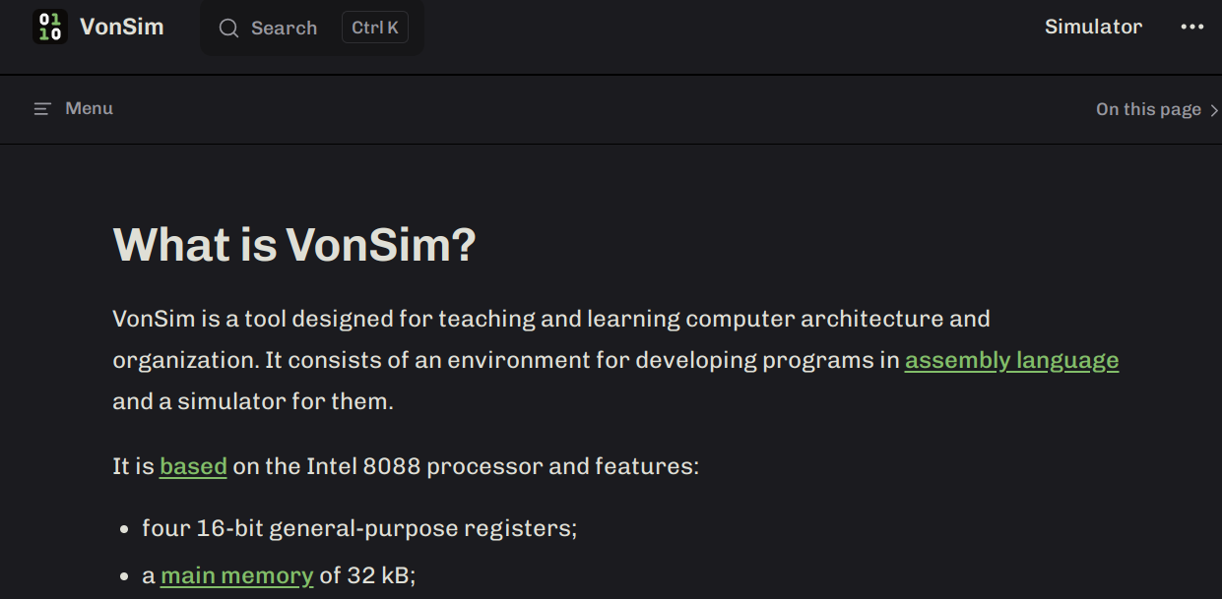
VonSim 2 Docs
https://vonsim.github.io/en/
Notes:
VonSim has a thorough and easy to read documentation, both in english and spanish.

Slide 9

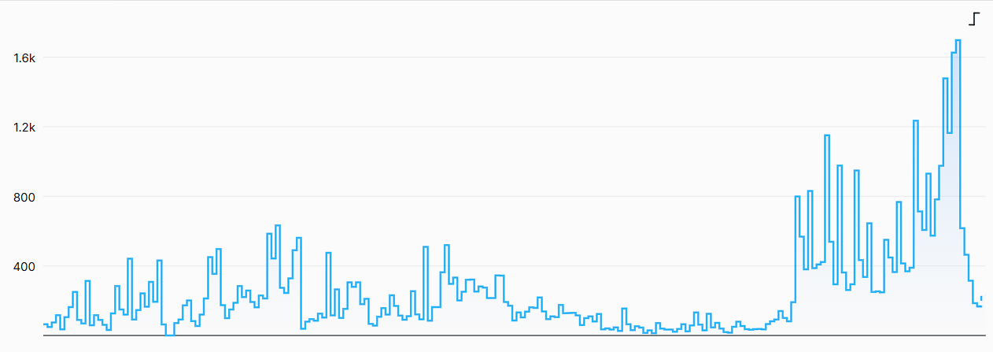
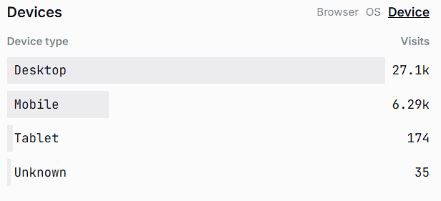
VonSim 2 Usage statistics
Via OneDollarStats (2025/03 - 2025/10)
Visits per day
Devices
Visitas
2021
Día
2022
Notes:
VonSim is used everyday by hundreds of students! Almost one-fourth of them use mobile devices.

Slide 10



VonSim 2 Team
Facundo Quiroga
https://github.com/facundoq
Juan Seery
https://github.com/JuanM04
https://github.com/vonsim/vonsim
Notes:
VonSim was originally developed by Facundo Quiroga, in Scala.
In 2023, Juan Seery rewrote the entire application in TypeScript using the React framework, improving maintainability and introducing many quality of life features such as animations, code export and color themes. Juan is also the current maintainer.
Try out VonSim at vonsim.github.com. You can also reach us at github.com/vonsim. Thank you for your interest in VonSim!

Slide 11

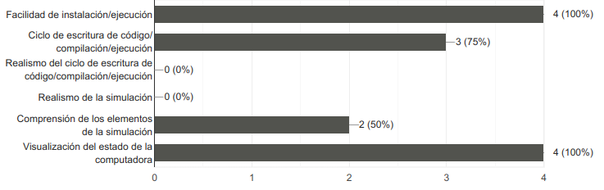
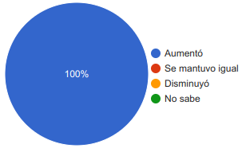
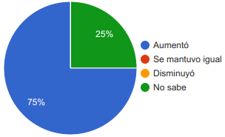
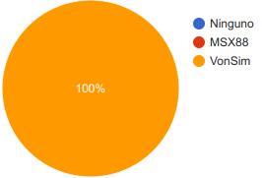
Evaluación docente
Vonsim (vs MSX88)
Encuesta inicial (n=4)
Uso mixto de ambos simuladores desde 2018
Motivación general
Tiempo de práctica
Simulador recomendado

Slide 12

MSX88
1990
Console only
Windows/Wine
No editor
> asm88.exe foo.asm
foo.O generado
> link88 foo.O
foo.eje generado
> msx88
(abre simulador)
>> l foo
(carga programa)
>> g
(comienza ejecución)

Slide 13
MSX88
Pedagogical Challenges
Confusing error messages
Long compile/test cycle
Practical difficulties
Does not work in mobile/tablet
Requires use of console
> asm88.exe foo.asm
foo.O generado
> link88 foo.O
foo.eje generado
> msx88
(abre simulador)
>> l foo
(carga programa)
>> g
(comienza ejecución)

Slide 14
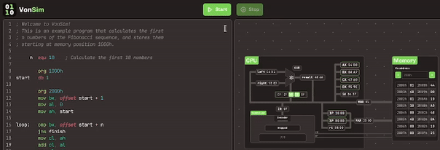
Data transfer animations

Slide 15
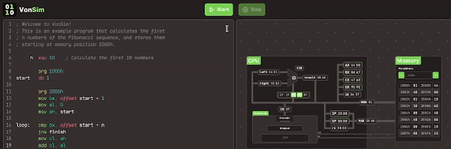
Instruction by instruction execution

Slide 16
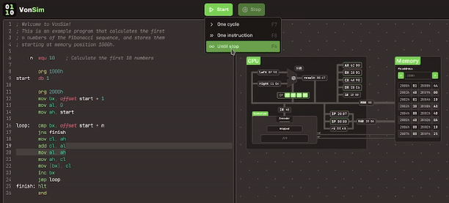
Quick run without animations

Slide 17
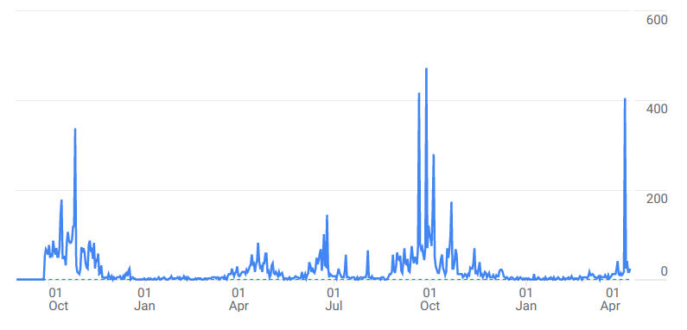
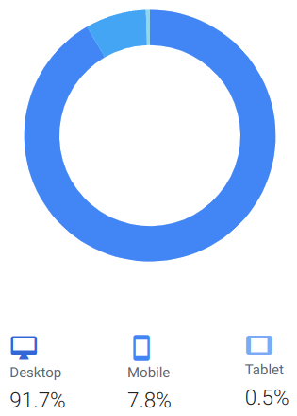
VonSim 1 Usage statistics
Via Google Analytics (2020/10 - 2021/04)
Visits per day
Devices
Exams
Visitas
2021
Día
2022

Slide 18
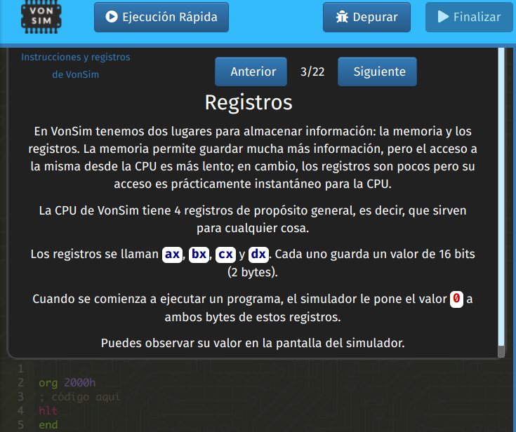
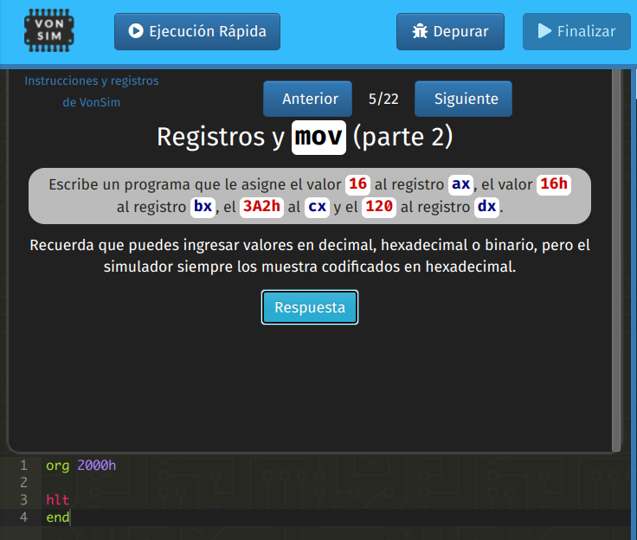
Tutoriales
Integrados en la aplicación
Ejercicios incluidos
Visitas

